Slide 1
Model Based Systems Engineering Approach to Applied Research S&T
Sponsored by
Professor Kristen Giammarco
Presented by
David Basala
Bill Berklich
Christy Brennan
Steve Mazza
Joe Rambousek
Dan Torres
On
13 March 2013

Slide 2
Executive Summary
In recent years there has been a dramatic increase in the volume of data gathered by the U.S. Navy in support of its operational efforts. While multiple channels are available to the Navy, Network Operations (NetOps) is a common methodology for moving the information as well as responding to system and network issues. NetOps is the U.S. Navy's operational construct designed to operate and defend the Global Information Grid (GIG) (NGEN NetOps CONOPSv1.0, DON, 7 Apr 2008). Specifically, NetOps provides the framework for contextual information leading to situational awareness and comprehension to make operational and mission decisions within the context of network operations and defense.
Determining and defining network events and their technical severity and mission implications so as to prioritize and react in a timely manner is critical to meeting the Navy’s operational needs.

Slide 3
Executive Summary (con’t)
Existing solutions cannot effectively provide data cohesion, fusion, common processing and interfacing across the diverse and growing operational datascape. Naval Watch Officers need to receive data in a timely manner to develop and deliver factual and actionable information to decision-makers on system outages, network degradations, or shifts in priorities.
The team applied a Model Based Systems Engineering Approach to identify a critical aspect of the problem to evaluate, scoped it appropriately, identified the requirements, develop a modeling process, collect the data, analyze the data and provide results.
The Graph database approach will have little impact on the reporting of information and the response to the outage specifically. The solution will however play a major role in not only collecting more data from more sources, but doing it in a more timely manner and a more logical approach to assist in the necessary assessment of that information. It was also noted that the database would not eliminate the need for manual input and assessment, but could assist.

Slide 4
MBSE Analysis Objectives
Utilize MBSE as a systems engineering tool to analyze the Graph DB approach and determine if a measurable improvement in effectiveness will result from the GdB application to this problem.

Slide 5
Essential Elements of Analysis (EEAs)
Can the systems engineering and analysis verify that the graph DB approach will provide a measurable improvement in effectiveness and success for the PACCOM decision makers’ process vs. a document DB approach?
Additional EEAs
If so, what confidence level can be associated with the magnitude of improvement in the various measures?
If the required improvements from a hardware and network architecture standpoint are implemented, can the graph DB approach be then verified as necessary to meet operational efficiency goals vs. maintaining the current process, services, apps, UIs, and APIs?
What average percent reduction in time is possible using the Ruby on Rails web app/Neo4j graph DB approach through the Acquire → Assess → Report operational activities performed by the watch officers vs. the current process?

Slide 6
Essential Elements of Analysis (EEAs)
What average time reduction is available to reestablish the COP/shared SA status for all surface platforms in the Pacific AOR with the proposed approach vs. the current process?
Can the analysis justify the selection of the current preferred solution approach of Neo4j graph DB implementation vs. another solution (Lucene, GIS, Rest API)?
Would any existing data source web apps still need to be directly and quickly accessible by watch officers in support of preparation of their briefs due to either the volume, or criticality of the data those apps contain and/or due to an inability to reliably extract/parse/convert or interpret the data through the fused graph DB solution?

Slide 7
Goal Hierarchy
Goal 1 - The graph DB approach will provide a measurable improvement in effectiveness and success for the PACOM decision makers’ process
Question 1.1 - What average percent reduction in time is possible using the Ruby on Rails web app/Neo4j graph DB approach through the Acquire → Assess → Report operational activities performed by the watch officers vs. the current process?
Metric 1.1.1 - Ruby on Rails web app/Neo4j graph DB approach through the Acquire → Assess → Report Process will reduce the current time by 20% (with a 90% confidence level)

Slide 8
Analysis Process & Techniques
Phase 1 – Scoping and Project Identification
This phase will consist of determining the problem, the scope of the problem that the team will be working to solve and the background for this problem. Some of the key tasks revolve around stakeholder analysis and defining the operational space to work within.
Phase 2 – Requirements Development
This phase will focus on the identification of requirements and developing criteria to evaluate those requirements. This will also be the phase in which the team will gather the necessary data and document to prepare for the Modeling and Analysis.
Phase 3 – Model Development
This phase will provide the development of the models for analysis. The Team will identify methods for analysis and modeling as well as construct the models. Finally, the Team will detail the analysis and model plan.
Phase 4 – Analysis
The final phase is model execution. The team will define a baseline with initial data, perform sensitivity analysis and then identify alterative configurations. Finally, the team will document and present the findings, and the process so it can be repeated in the future.
Notes:
The cornerstone of our general approach has been to gather information through study of the problem and interview. The stakeholders have supplied us with review material summarizing their problem space and proposed high level architecture which has given us the basis to focus our interview questions to best effect. Our recent interview session with the stakeholders provided us with the added insight necessary to drill down into the problem space and begin our analysis in earnest.
As we move through the systems engineering process, analysis will be a continual and integral part that will provide a feedback loop against which we can measure our progress and course of action. Although analysis will be ongoing, the majority of the early analysis that will allow us to move forward should be complete within two weeks.
Given sufficient information to gain early traction, we will refocus our analysis efforts on modeling the system. Given that we do not have access to the actual system under development, we will rely on the critical information gained through interview and study. The modeling effort, if carefully carried out, will give us much needed access to a surrogate for the system under development and will lend insight into the feasibility of different proposed courses of action. This real time feedback will make it possible for us to provide the stakeholders with a reliable engineering plan.

Slide 9
Measures
Increase Effectiveness of the Current Process
MOE
Increase number of sources
MOP
Increase # of sources by 15% (with a 90% confidence level)
TPM
Reduce amount of time to Acquire – Assess – Report
MOP
Reduce the current time by 20% (with a 90% confidence level)
TPM

Slide 10
Examples of Models - Use Case

Slide 11
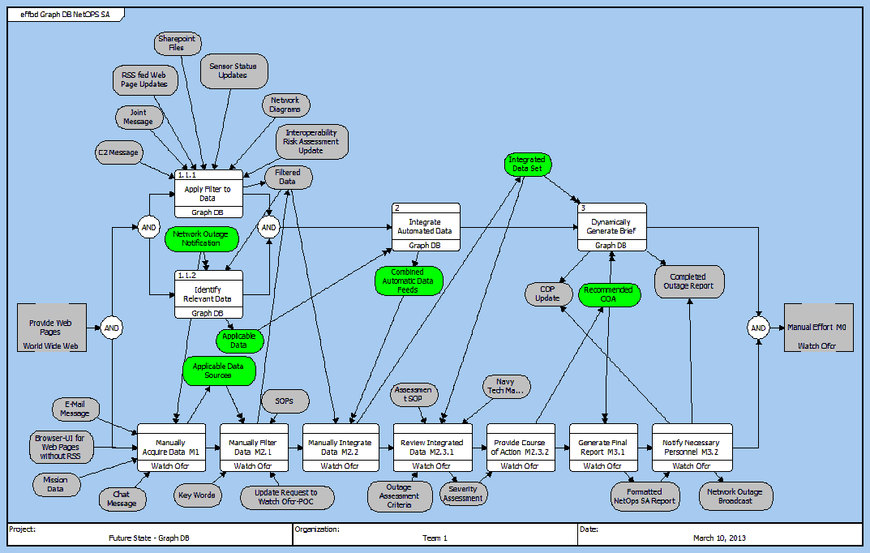
Examples of Models - EFFBD

Slide 12
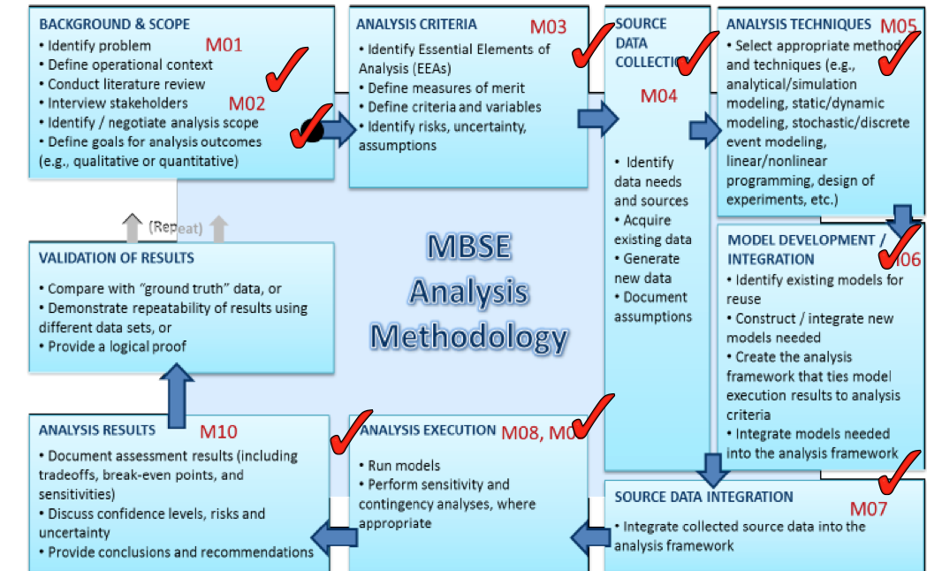
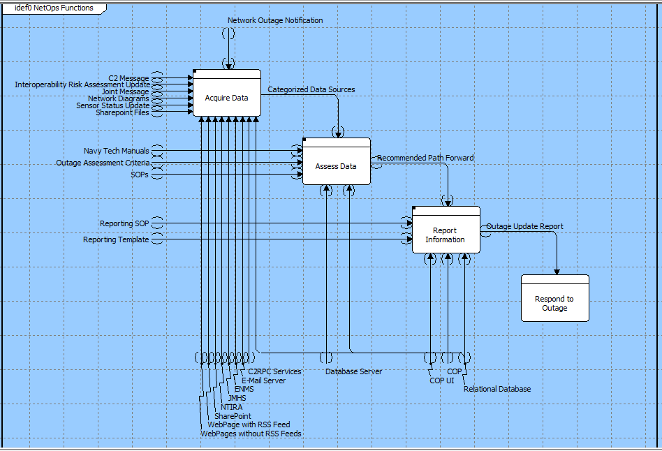
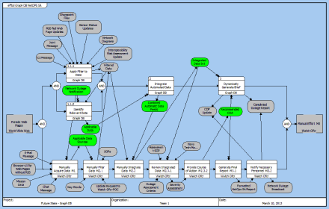
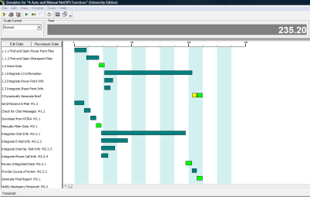
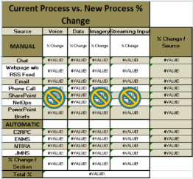
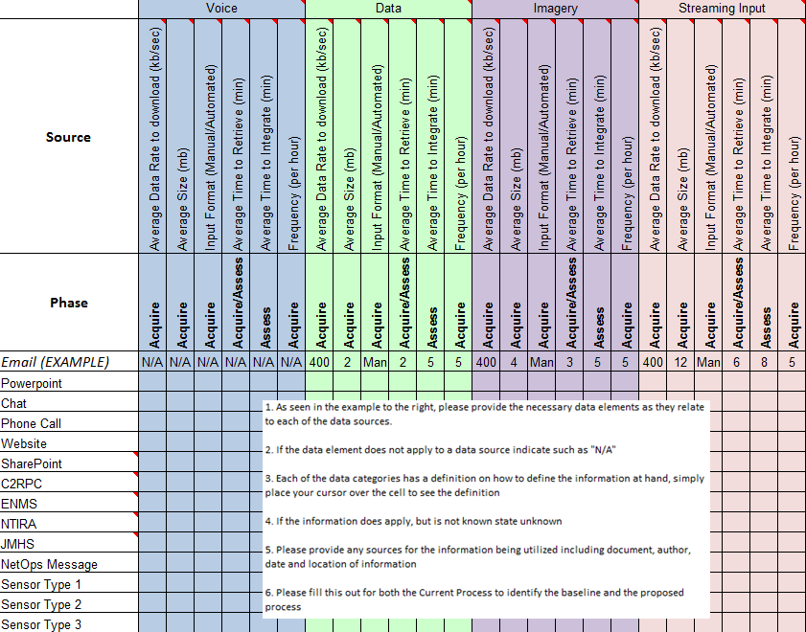
MBSE Analysis Framework
Utilized CORE to identify high level use cases for the Graph Database System
Utilized CORE to develop the IDEF0 for both the current process and the future process
Utilized CORE to create the EFFBD for the future process to identify where the system and other meta elements interact
Utilized CORE simulation with the EFFBD in combination with the collected data to run validation of numbers against the process including the manual effort portions
Utilized Excel to develop an initial BOE for the data elements of the process and determine a baseline
Utilized Excel to collect necessary data to determine baseline data for required functions
Notes:
Major focus will be on data collection, analysis methodology and model development
Recursive process, necessary to revisit risks, assumptions, constraints, EEAs and requirements often, especially as analysis gets underway
Stay connected with Stakeholders

Slide 13

Neo4j Performance
The following formula models graph database performance using brute force search of purely random strings without spaces and is part of a paper published as part of the ACM SE 10 ACM Southeast Regional Conference in Oxford, MS, during April 15 - 17, 2010.
In real world performance, Neo4j would leverage Lucene to provide pre-indexed search capability and greatly improve performance.

Slide 14
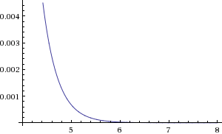
Equation Derivation
There are 26^{d} strings of length d in a 26-alphabet.
The specific search string is one of these: (1/26)^{d}.
The probability that the current search string is not the desired string is 1 – (1/26)^{d}.
The probability of the current payload (node) not containing the search string is 1 – (1 – (1/26)^{d})^{n}, for all values of n significantly greater than d.
And we scale by the number of nodes: N(1 – (1 – (1/26)^{d})^{n}).
Notes:
This is effectively an exponential curve that takes into account the statistical likelihood of locating the search string and scales by the number of nodes.
N = the number of nodes in the graph database
n = the size of the search string
d = the size of each string being searched (the node’s payload)
The plot shows performance where n=8000, d = 4 to 8, and N = 1000 to 100,000.

Slide 15

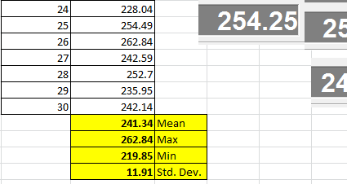
Analysis Results
Initial analysis of 30 simulation runs of the GdB model

Slide 16
Analysis Results (Con’t)
Preliminary model assumes maximum number of users on system (10)
Scaling factors applied to retrieval and integration times based on frequency feedback (all from data call responses)
New Graph DB process accounts for (approximately) just over 4 hours processing time, with almost 12 minute SD
“Better” constants or distributions needed for functions that are not changing with Graph DB implementation
Function sequencing assumptions need confirmation
Where distributions were applied, assumed normal with 10% SD

Slide 17
Conclusions and Recommendations
Biggest Return on Investment for the GB is in the Data Acquisition Phase (based on Vickniar)
The graph database has little effect on the manual labor required to input information
The graph database excels over a RDBMS for searching unstructured text (e.g., articles, reports, documents, Power Point).
MBSE provides a structured approach to analyzing this problem which can be repeated in the future to look at different elements of the process for a different solution set
MBSE also allows for a model based approach as opposed to a document approach such as Word or Visio, which creates issues in configuration control and does not allow for identification of interactions and linkages as done in a model based system such as CORE.

Slide 18
Back Up

Slide 19
System Context Diagram

Slide 20
Data Collection Questions
What are the areas of most concern in the current process?
Acquire
Access
Report
What are the most critical sources of information?
Currently how many man hours does it take to acquire – assess – report an outage (on average)?

Slide 21
Data Collection
Notes:
1. As seen in the example to the right, please provide the necessary data elements as they relate to each of the data sources.
2. If the data element does not apply to a data source indicate such as "N/A"
3. Each of the data categories has a definition on how to define the information at hand, simply place your cursor over the cell to see the definition
4. If the information does apply, but is not known state unknown
5. Please provide any sources for the information being utilized including document, author, date and location of information
6. Please fill this out for both the Current Process to identify the baseline and the proposed process

Slide 22
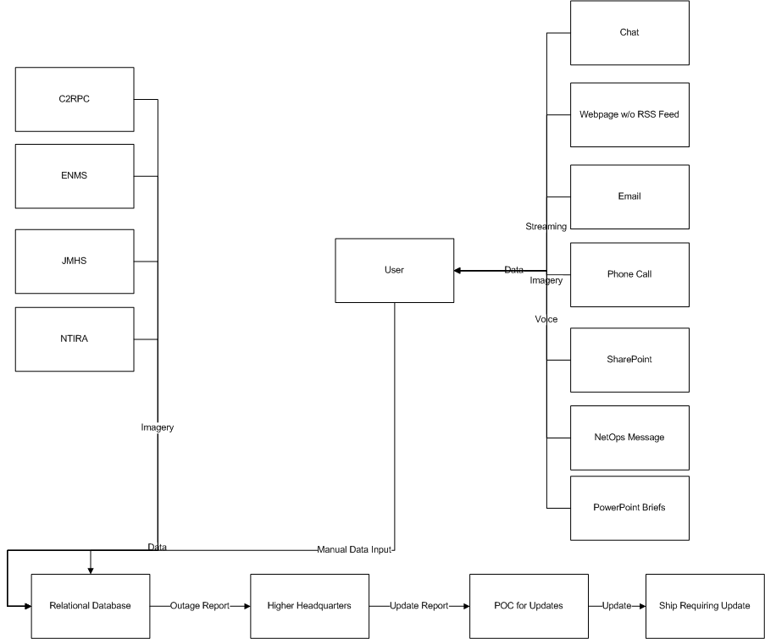
Current Approach (Draft)
Acquire
Assess
Report
Respond

Slide 23
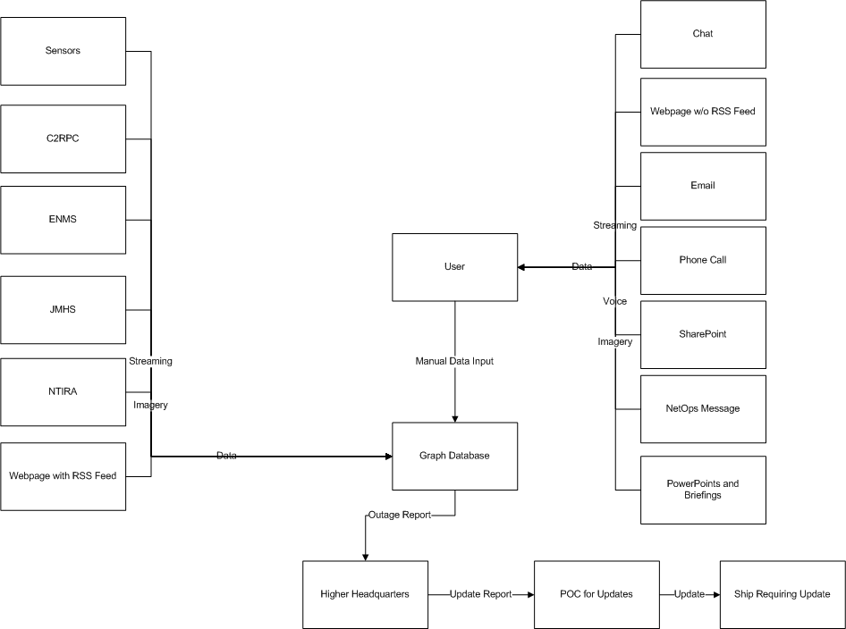
Future Approach (Draft)
Acquire
Assess
Report
Respond

Slide 24
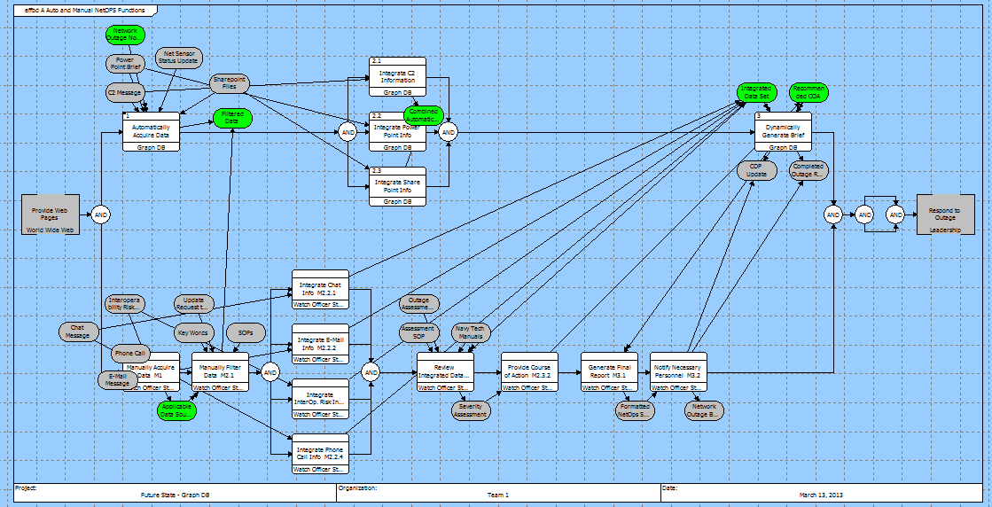
EFFBD for Simulation
Notes:
1. As seen in the example to the right, please provide the necessary data elements as they relate to each of the data sources.
2. If the data element does not apply to a data source indicate such as "N/A"
3. Each of the data categories has a definition on how to define the information at hand, simply place your cursor over the cell to see the definition
4. If the information does apply, but is not known state unknown
5. Please provide any sources for the information being utilized including document, author, date and location of information
6. Please fill this out for both the Current Process to identify the baseline and the proposed process

